Slide 1


Don’t talk to strangers
Test isolation with containers
Hristo Iliev, Georgi Sabev | SAP Labs
18-19 November, Sofia

Slide 2
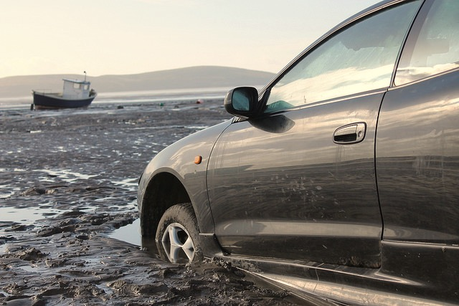
Test pollution
ISTAcon.org
18-19 November, Sofia

Slide 3

Resources left behind
Environment variables
Database records
Files
Programs / libraries
ISTAcon.org
18-19 November, Sofia

Slide 4
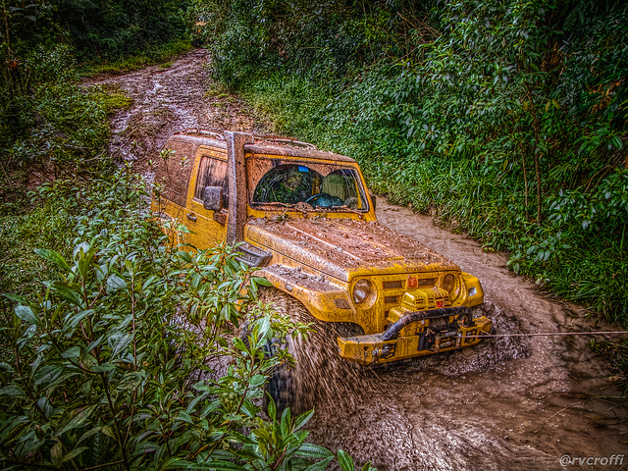
Popular solutions
Workspace Folders
Cleanup Scripts
Discipline
ISTAcon.org
18-19 November, Sofia

Slide 5
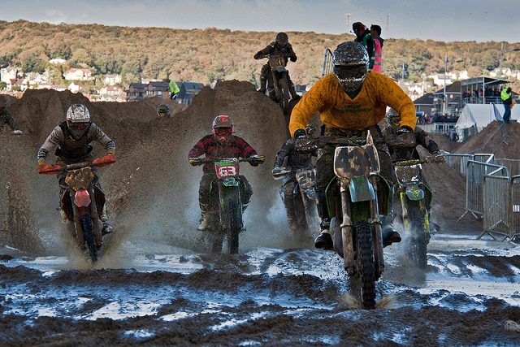
Resource contention CPU & Memory
ISTAcon.org
18-19 November, Sofia

Slide 6
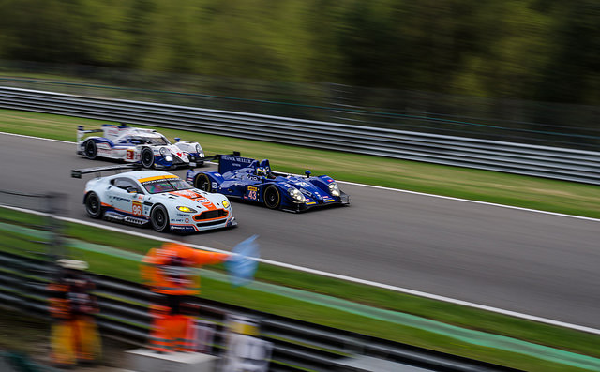
Resource contention
Processes compete for
CPU
Memory
I/O
ISTAcon.org
18-19 November, Sofia

Slide 7
Popular solutions
???
ISTAcon.org
18-19 November, Sofia

Slide 8
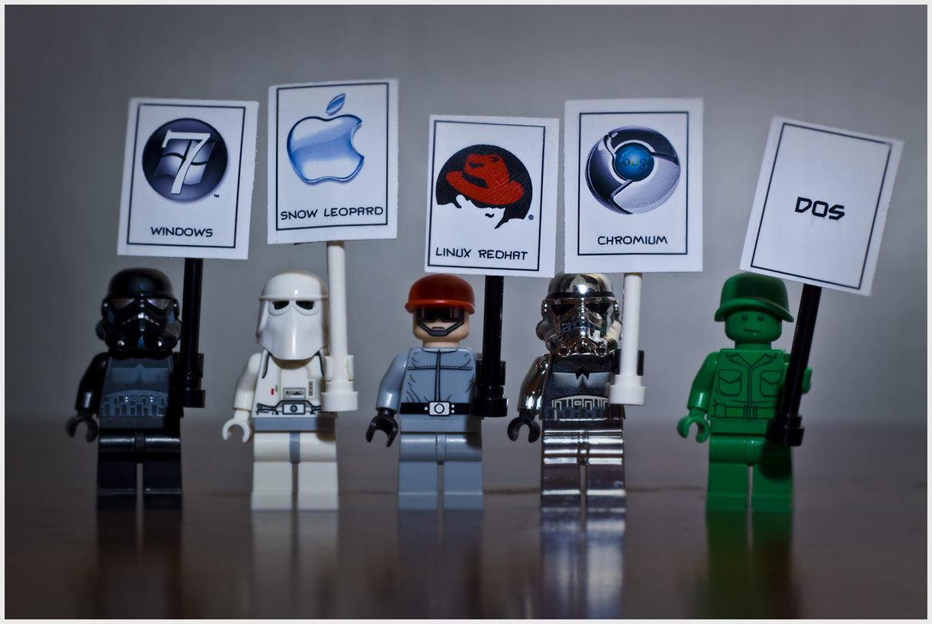
Multiple environments
ISTAcon.org
18-19 November, Sofia

Slide 9
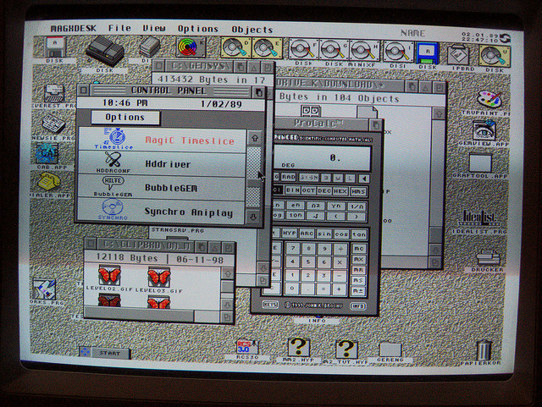
Build and test
Environment
OS
Mobile / Desktop
Cloud / Standalone
Databases
Versions
ISTAcon.org
18-19 November, Sofia

Slide 10

Popular solutions
Dedicated hardware
Virtual machines
Cloud: AWS, Azure
ISTAcon.org
18-19 November, Sofia

Slide 11
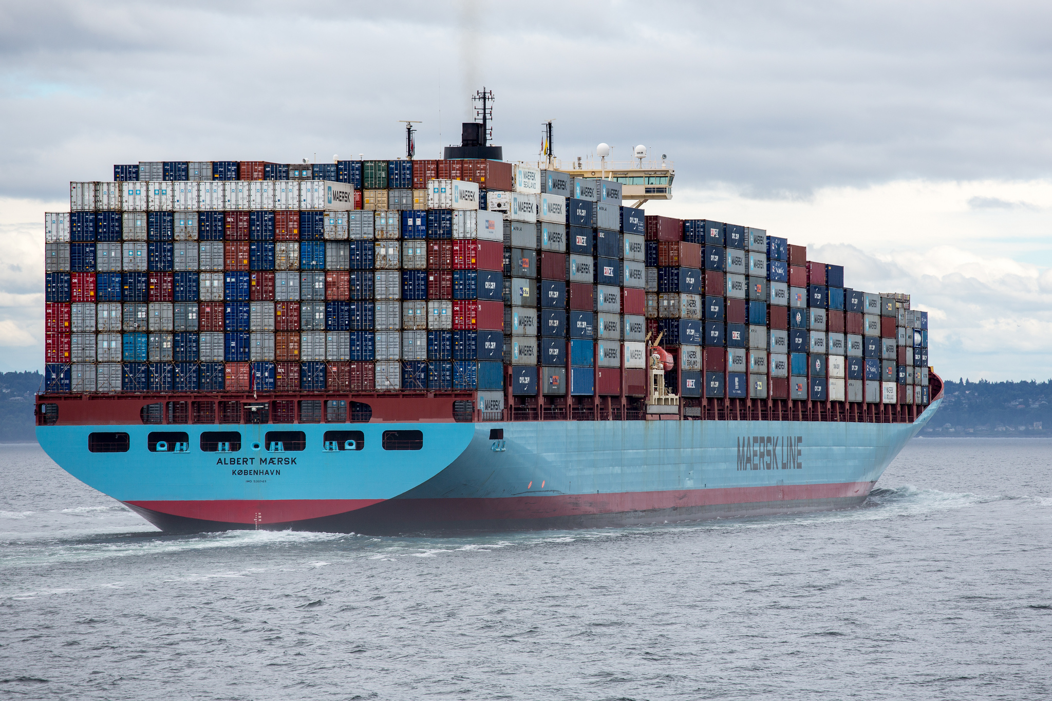
Containers build, isolate, ship
ISTAcon.org
18-19 November, Sofia

Slide 12

Containerization = Lightweight Virtualization
Virtual Machine
Virtual Machine
App
App
App
App
Container
Container
App
App
App
App
Bins / libs
Bins / libs
Operating System
Operating System
Bins / libs
Bins / libs
Hypervisor
Operating System
Hardware
Hardware
Virtualization
Containerization
ISTAcon.org
18-19 November, Sofia

Slide 13
Container: Resource isolation
Shared resources
Kernel
Process A
Process E
Process B
Process C
Process D
Process F
Tenant 1
Tenant 2
Tenant 3
ISTAcon.org
18-19 November, Sofia

Slide 14
Container: Resource isolation
A
B
C
D
E
F
Kernel
Process A
Process E
Process B
Process C
Process D
Process F
Tenant 1
Tenant 2
Tenant 3
ISTAcon.org
18-19 November, Sofia

Slide 15
Container: Resource isolation
CPU
A
B
C
D
E
F
Kernel
cgroups
Process A
Process E
Process B
Process C
Process D
Process F
Tenant 1
Tenant 2
Tenant 3
ISTAcon.org
18-19 November, Sofia

Slide 16
Container: Namespace isolation
Process ID
A
B
C
D
E
F
Kernel
Process A
Process E
Process B
Process C
Process D
Process F
Tenant 1
Tenant 2
Tenant 3
ISTAcon.org
18-19 November, Sofia

Slide 17
Container: Namespace isolation
Process ID
A
B
C
D
E
F
Kernel
Process A
Process E
Process B
Process C
Process D
Process F
Tenant 1
Tenant 2
Tenant 3
ISTAcon.org
18-19 November, Sofia

Slide 18
Container: Namespace isolation
Process ID
A
B
C
A
A
B
Kernel
Same PID
Process A
Process A
Process B
Process C
Process A
Process B
Tenant 1
Tenant 2
Tenant 3
ISTAcon.org
18-19 November, Sofia

Slide 19
Container: Namespace isolation
PID,Network,Mount,User
Kernel
Process A
Process B
Process C
Process A
Process A
Process B
Tenant 1
Tenant 2
Tenant 3
ISTAcon.org
18-19 November, Sofia

Slide 20

Container
Network
PID
?
=
+
+
cgroups
User
Isolation
Content
Processes
ISTAcon.org
18-19 November, Sofia

Slide 21
Container
Network
PID
cgroups
User
ISTAcon.org
18-19 November, Sofia

Slide 22
Container actions
Make me a container
Put this in it
Run this for me
ISTAcon.org
18-19 November, Sofia

Slide 23
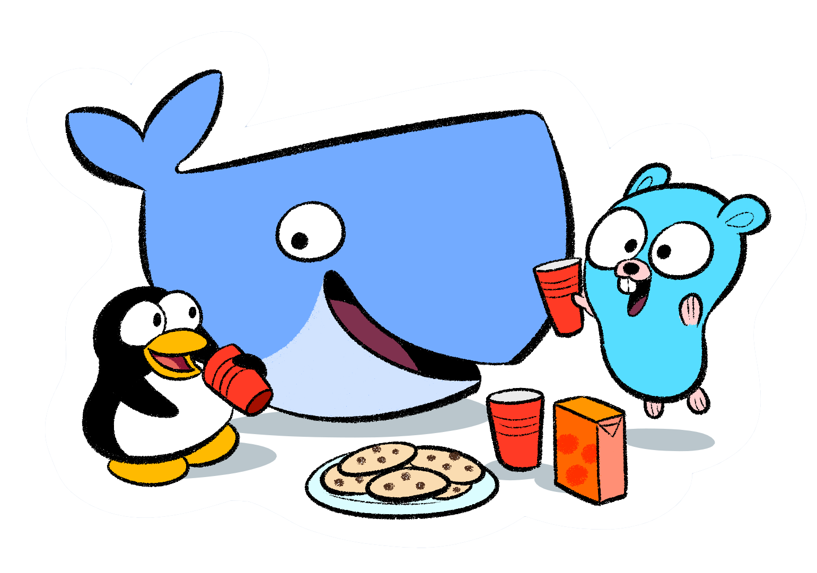
Docker
“Build, Ship, Run” Containers
Dockerfile
Docker image
Docker Hub
ISTAcon.org
18-19 November, Sofia

Slide 24
Dockerfile
Make me a container
Put this in it
Run this for me
ISTAcon.org
18-19 November, Sofia

Slide 25
Dockerfile
Example:
FROM debian:stable
RUN apt-get update && apt-get install -y --force-yes apache2
EXPOSE 80 443
VOLUME ["/var/www", "/var/log/apache2", "/etc/apache2"]
ENTRYPOINT ["/usr/sbin/apache2ctl", "-D", "FOREGROUND"]
ISTAcon.org
18-19 November, Sofia

Slide 26
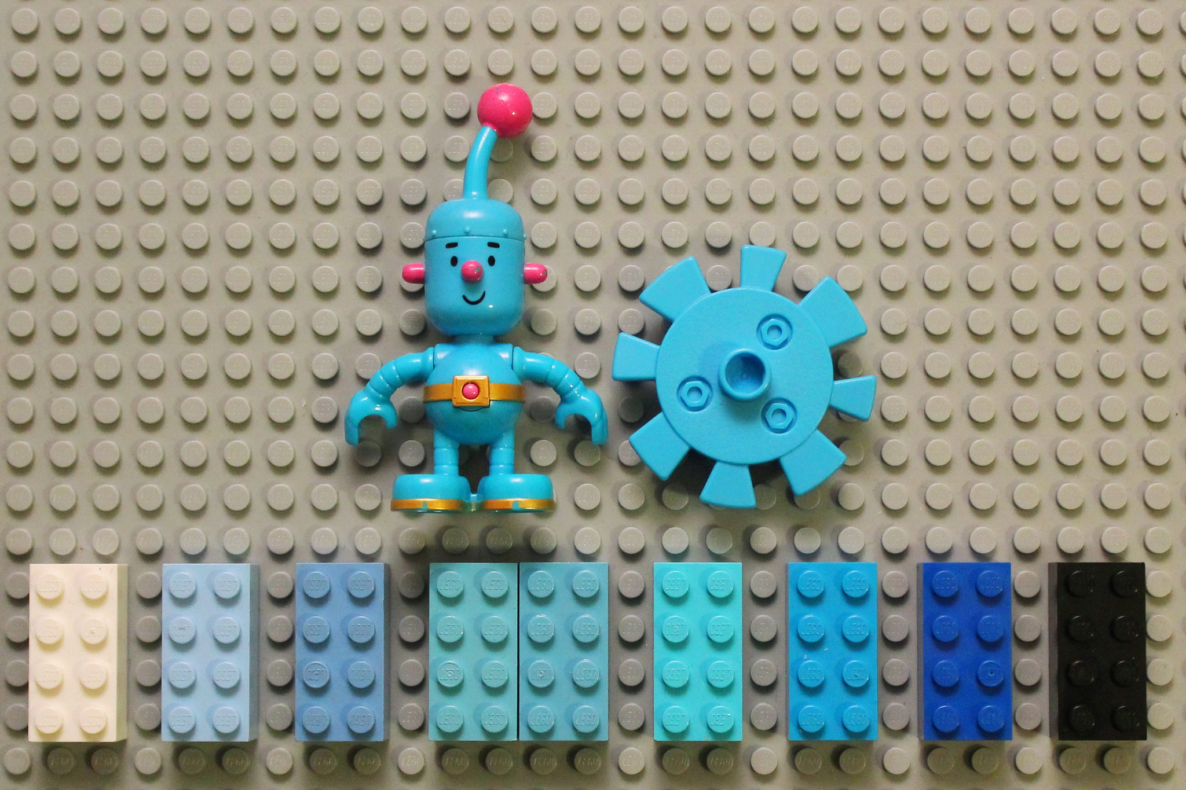
Demo
ISTAcon.org
18-19 November, Sofia

Slide 27
Containers: Pros & Cons
Pros
Isolation
Reproducible environment
Easy to maintain
Cons
Multi-platform
Discipline
ISTAcon.org
18-19 November, Sofia
Notes:
Linux only. Windows requires different VM
Discipline – cleanup still needed. CPU and memory contention is problem in containers too. This has to be addressed in the same way as with VM/standalone env.

Slide 28

Pipelines Multiple-builds
ISTAcon.org
18-19 November, Sofia

Slide 29
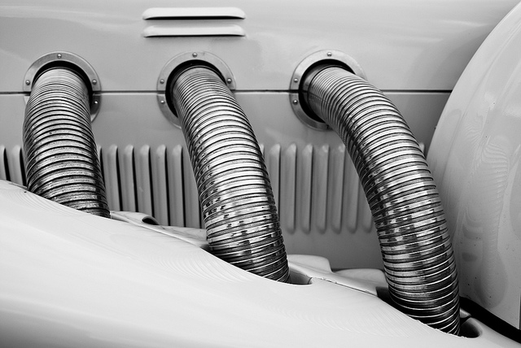
Continuous Integration & Delivery
Multiple
Environments
Products
Teams
Final release
ISTAcon.org
18-19 November, Sofia

Slide 30
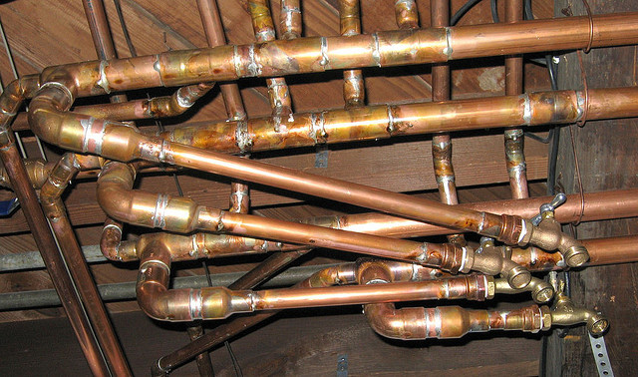
Popular solutions
Build servers
Jenkins
Travis
…
Homegrown
ISTAcon.org
18-19 November, Sofia

Slide 31
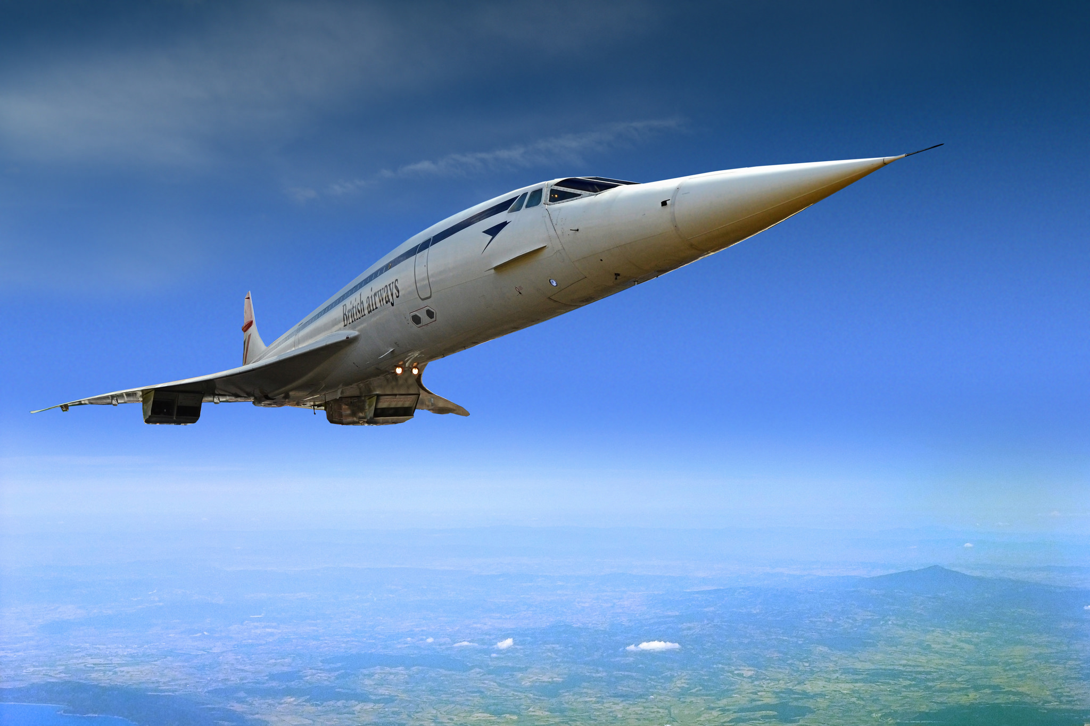
Concourse CI, Pipelines, Delivery
ISTAcon.org
18-19 November, Sofia

Slide 32
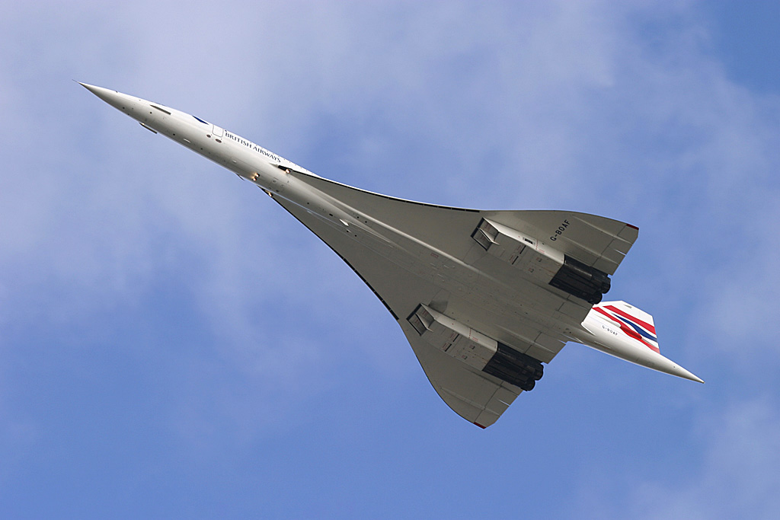
Concourse
CI
Reproducible builds
Simple resources
Docker
ISTAcon.org
18-19 November, Sofia

Slide 33
Concourse: Concepts
Tasks
Resources
Jobs
Build Job
Configure
Make
Install
Source
Binary
ISTAcon.org
18-19 November, Sofia

Slide 34
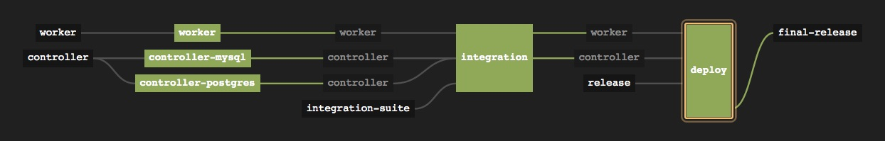
Concourse: Pipeline
validated resource
job
resource
ISTAcon.org
18-19 November, Sofia
Notes:
Resources:
Worker
Controller
Integration suite
Release
Final-release
Jobs:
Worker build & unit test
Controller build & mysql test
Controller build & postgres test
Integration test
Deploy

Slide 35
Concourse: Pipeline YML
resources:
- name: source
type: git
source:
uri: source.git
branch: master
jobs:
- name: build
plan:
- get: source
- task: build
file: build.yml
ISTAcon.org
18-19 November, Sofia

Slide 36
Demo
ISTAcon.org
18-19 November, Sofia

Slide 37
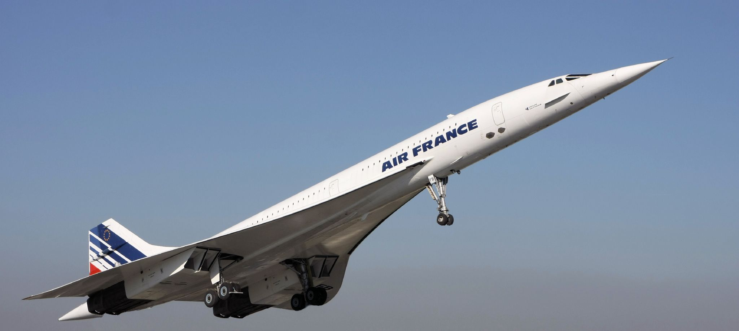
Concourse: Pros & Cons
Pros
Reproducible environment
Native pipeline support
Release process modeling
Cons
Maturity
Pipeline management
Scripting
ISTAcon.org
18-19 November, Sofia
Notes:
Pros
Reproducible environment – configuration in pipeline.yml
Native pipeline support – pipeline = resources + tasks & jobs
Release process modeling – easy to model the whole (end to end) release process
Cons
Maturity – not matury. A lot of changes
Pipeline management – build & support of pipelines is hard
Scripting – a lot of scripting involved in tasks/jobs

Slide 38

Integer tincidunt libero a ex venenatis cursus. Vivamus accumsan congue tristique.
Up to
Six bullets
For best results
Up to
Six bullets
For best results
ISTAcon.org
18-19 November, Sofia

Slide 39
Major point without a picture
And its subtitle
ISTAcon.org
18-19 November, Sofia

Slide 40
Integer tincidunt libero a ex venenatis cursus. Vivamus accumsan congue tristique.
Up to
Six bullets
For best results
Up to
Six bullets
For best results
ISTAcon.org
18-19 November, Sofia

Slide 41
Integer tincidunt libero a ex venenatis cursus. Vivamus accumsan congue tristique.
Up to
Six bullets
For best results
Up to
Six bullets
For best results
ISTAcon.org
18-19 November, Sofia

Slide 42

Integer tincidunt libero a ex venenatis cursus. Vivamus accumsan congue tristique.
ISTAcon.org
18-19 November, Sofia

Slide 43
Integer tincidunt libero a ex venenatis cursus. Vivamus accumsan congue tristique.
ISTAcon.org
18-19 November, Sofia

Slide 44











Some icons for use throughout the presentation
ISTAcon.org
18-19 November, Sofia

Slide 45

Thank you!
hristo.iliev@sap.com
georgi.sabev@sap.com
Hristo Iliev, Georgi Sabev | SAP Labs
18-19 November, Sofia

